Slide 1
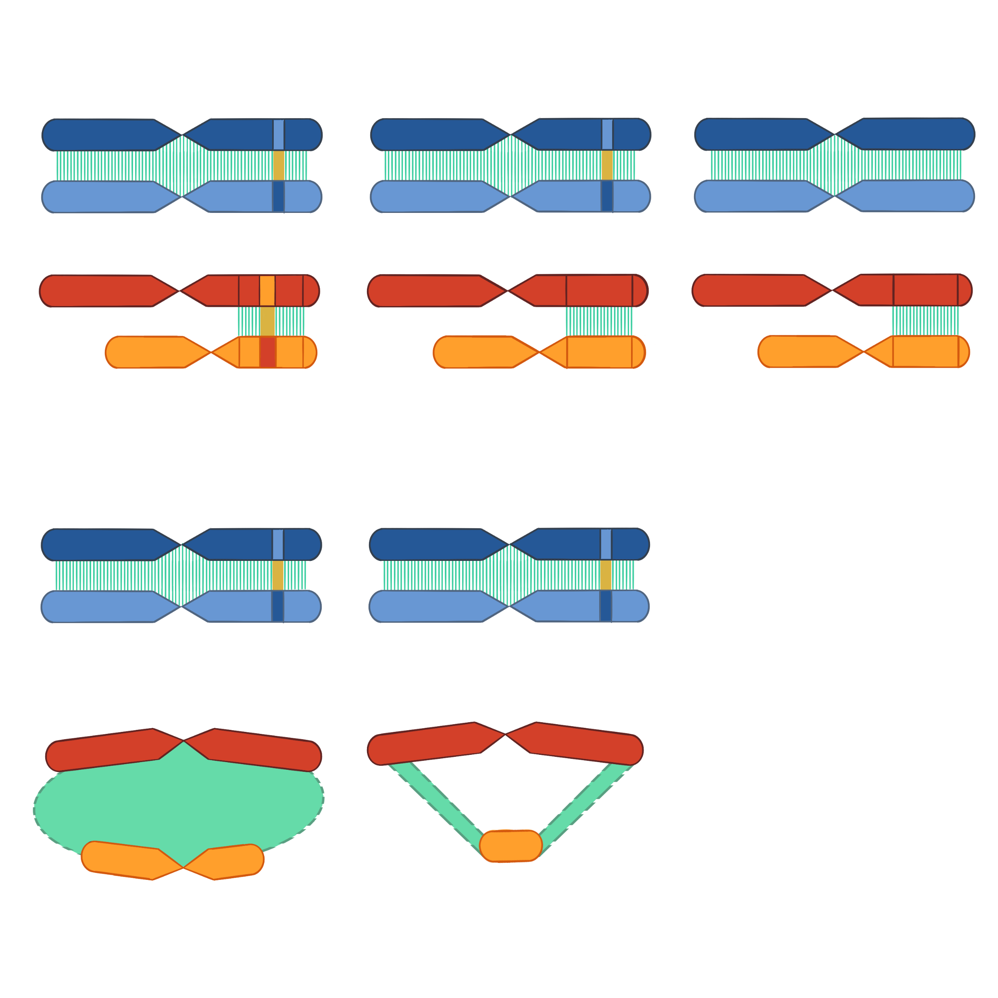
A) Chiasmatic Meiosis
B) Achiasmatic Sex Chromosomes
C) Achiasmatic Meiosis
Autosomes
Sex Chromosomes
D) Asynaptic Sex Chromosomes
Metatheria
Coleoptera
Autosomes
Sex Chromosomes
Dense Plate
Xyp

